Slide 1
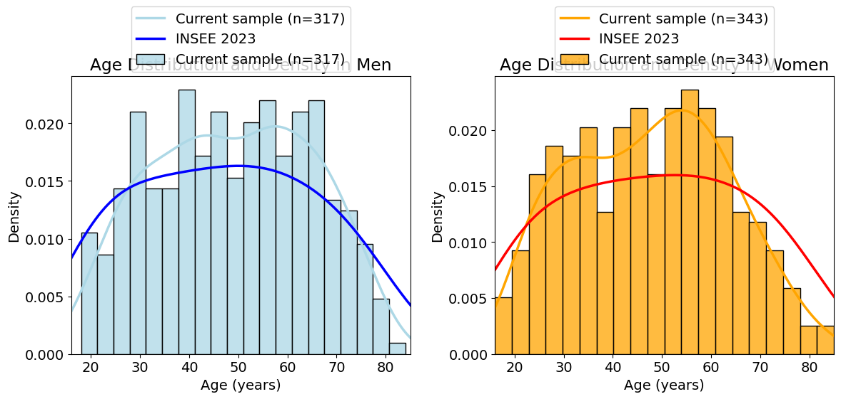
a b
Participants from the ImVesPerSE cohort
(n = xxx)
Participants from the PERSOCOR cohort
(n = xxx)
Exclusion (n = xx)
Multiple missing data (n = xx)
Exclusion (n = xx)
Multiple missing data (n = xx)
Total participants included
(n = 660)
Participants from the VESTICOR cohort
(n = xxx)
a b
ImVesPerSE cohort
(n = xxx)
PERSOCOR cohort
(n = xxx)
VESTICOR cohort
(n = xxx)
Exclusion (n = xx)
Multiple missing data (n = xx)
Exclusion (n = xx)
Multiple missing data (n = xx)
Exclusion (n = xx)
Multiple missing data (n = xx)
Total participants included
(n = 660)

